Slide 1
Visual Studio SSAS Project
Connect to sql server instruction

Slide 2
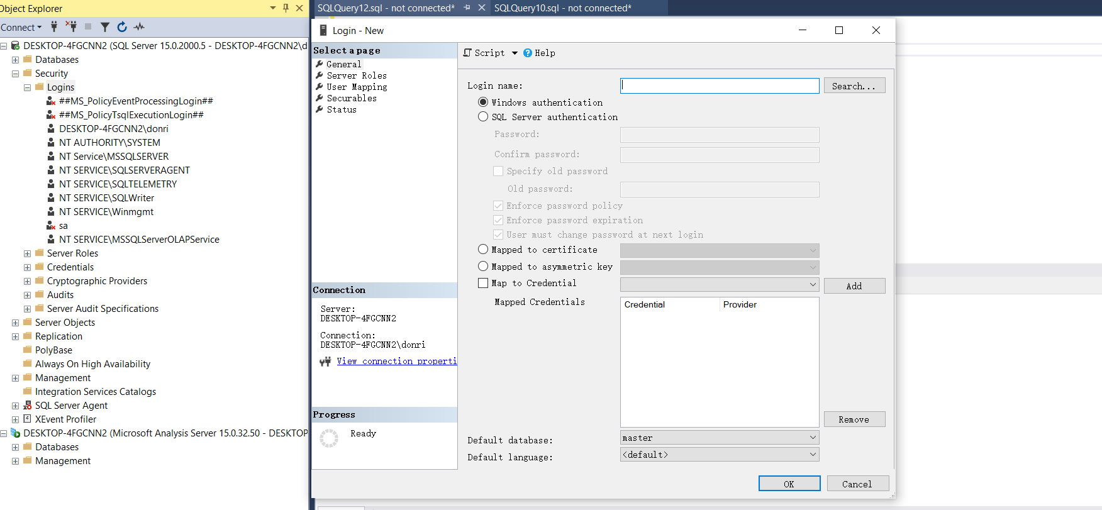
1, step is go to sql server, add the new login user in Database

Slide 3
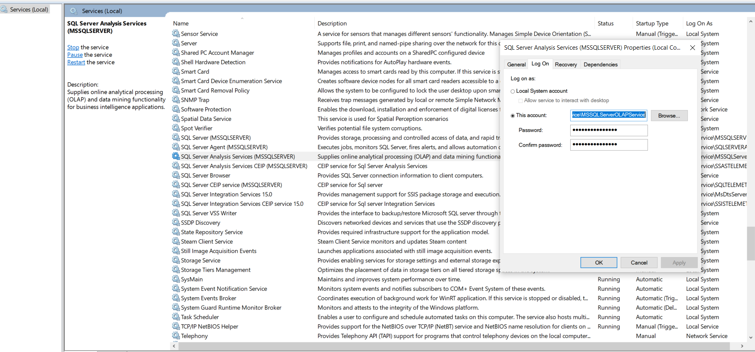
2, go to the service window by in the command mode, type services.msc,chose ssas service, and then click the properties, in the properties windows, copy the account name

Slide 4
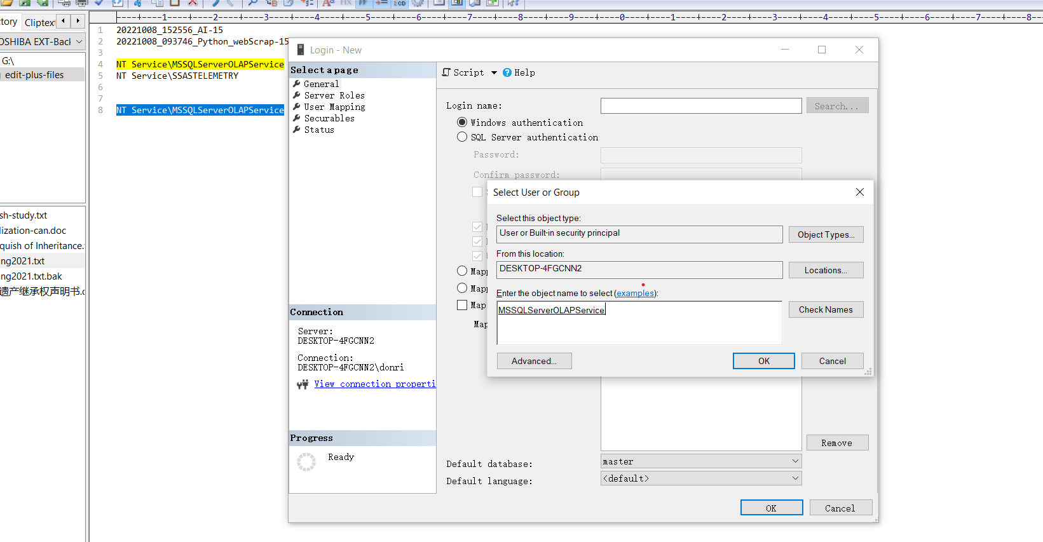
3, go back the first window or the 2nd page in this struction, click the search button, past the copy account name like below image, click check name, than ok

Slide 5
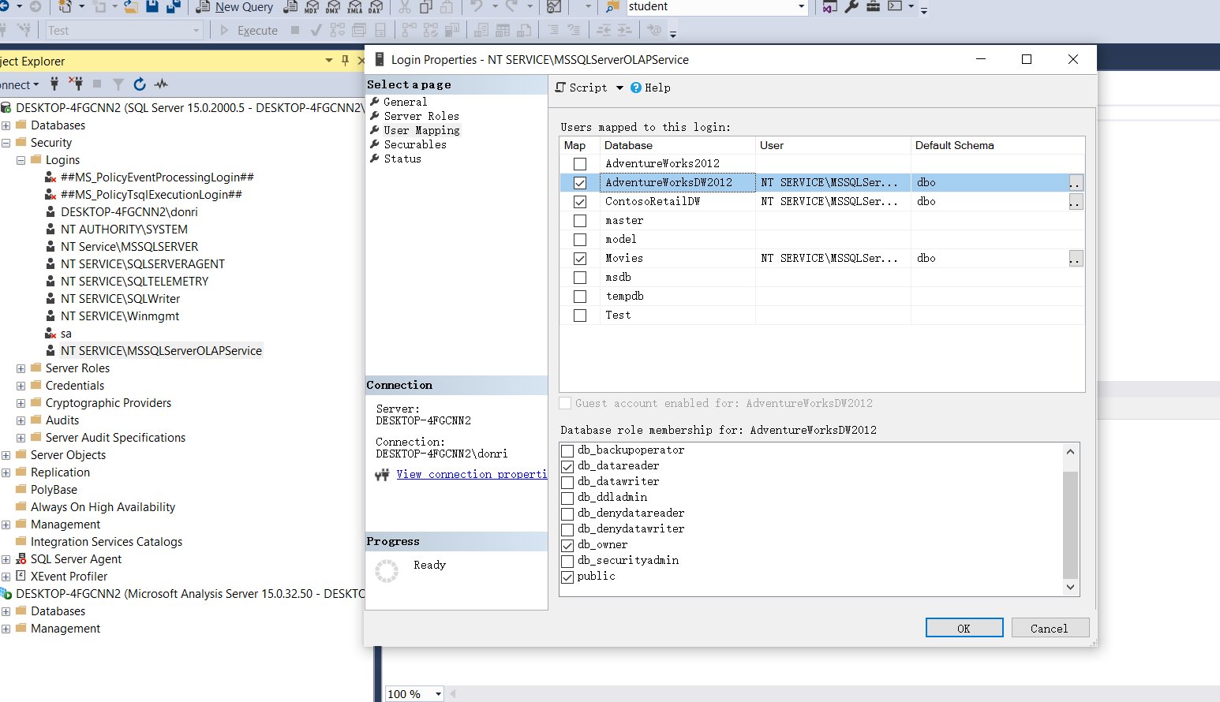
4, at the select pages window, click the User mapping, in the right windows chose the database you want to access, in the bottom window, click the db_owner option, and then click ok, now you are all set on account create.

Slide 6
5, at the select pages window, click the User mapping, in the right windows chose the database you want to access, in the bottom window, click the db_owner option, and then click ok, now you are all set on account create.

Slide 7
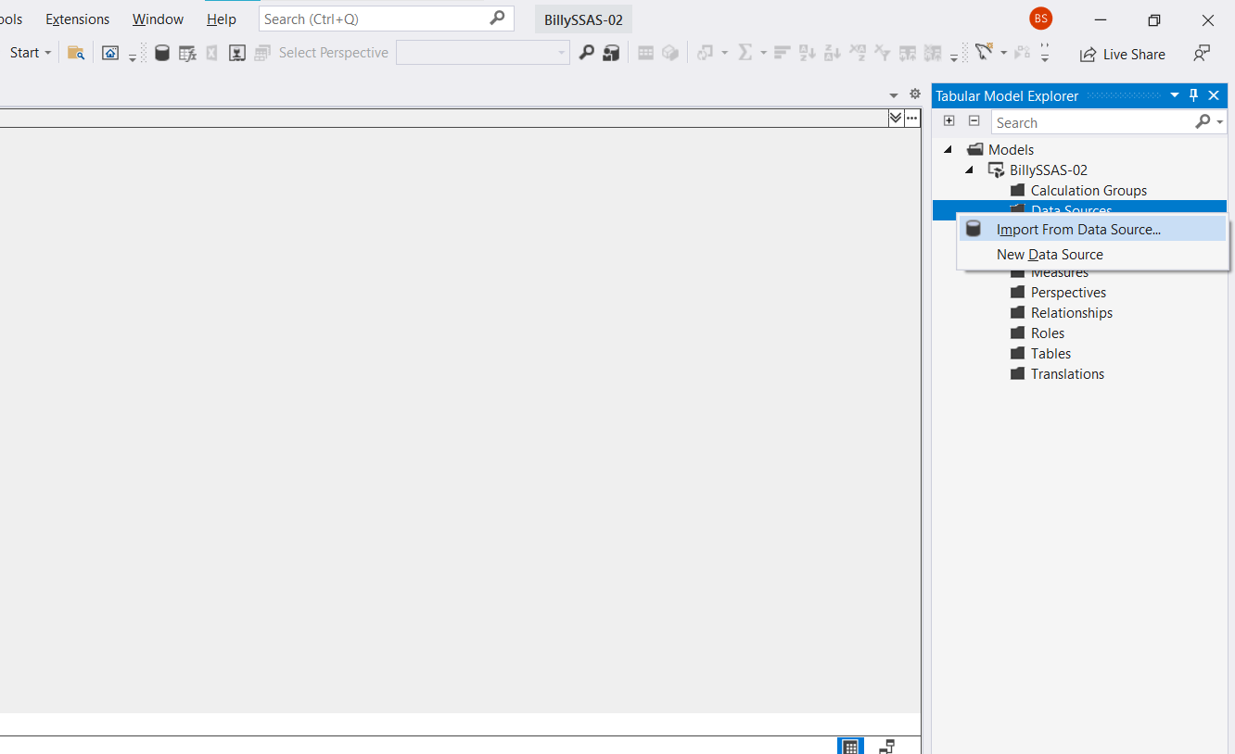
6, run the visual studio and create a new SSAS Project, at new project window, go to the right site at Tabular Model Explore Window, click the Data Source, click import from data source.

Slide 8
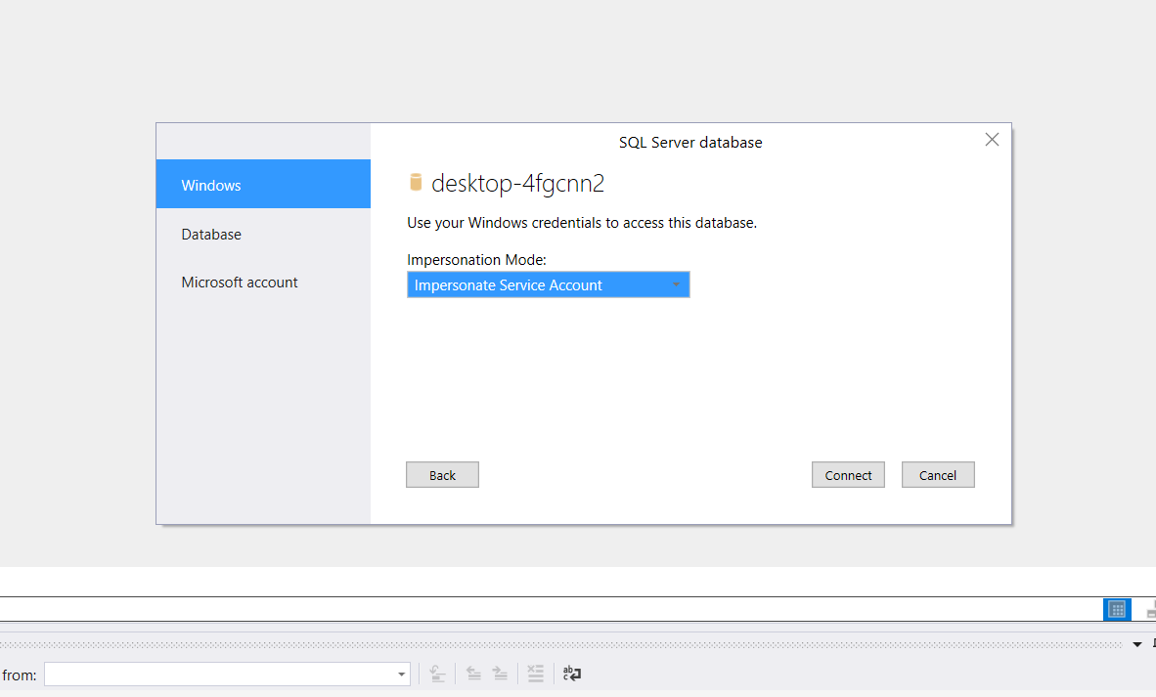
7, create the data source by all the default option when you meet Access SQL Analysis Services window, chose the Impersonate Service Account, and then click connect

Slide 9
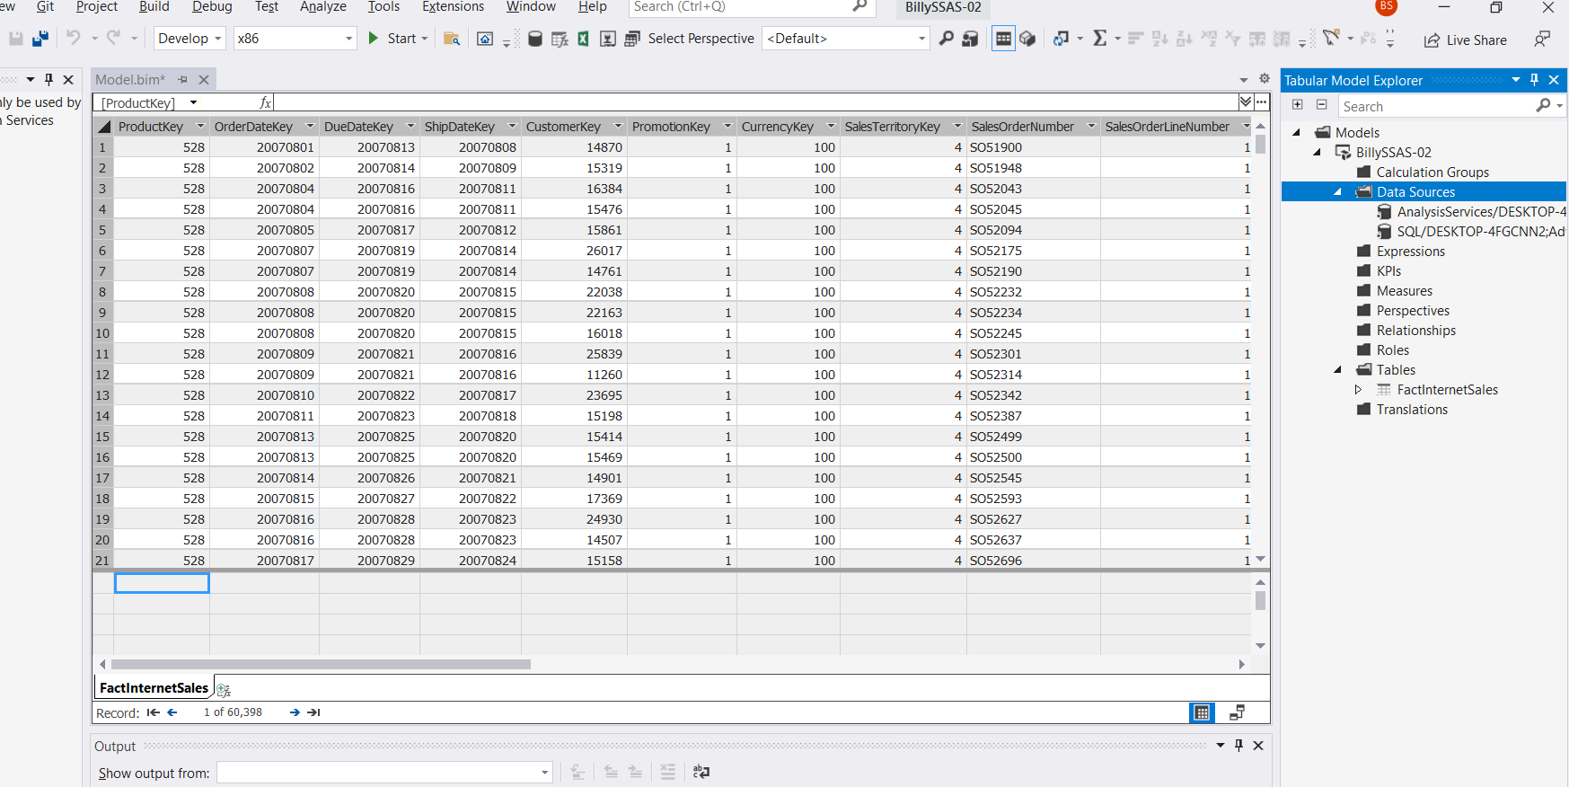
8, Last at the table select window(Navigator), click the FactInternetSales and also click the “Select Related Tables,all the assosciated table will be selected, then click “Load” button, now you can start developing a tabular project, enjoy it, any questions let me know in webchat.

